Slide 1
Teaching Portfolio
Alexa Stein
Childhood Inclusive Education with a concentration in Spanish

Slide 2
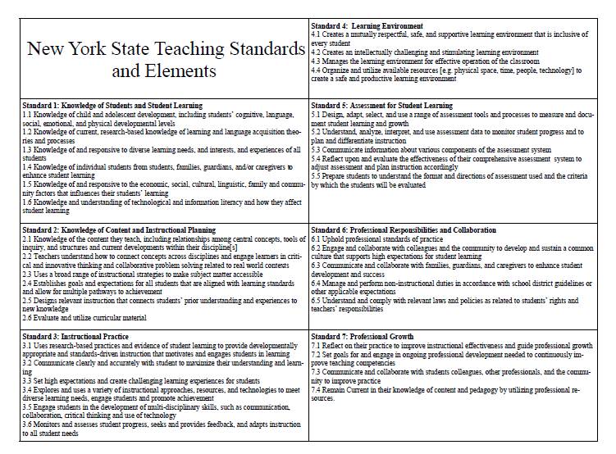

Slide 3
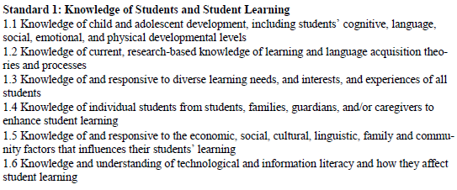
Standard 1: Knowledge of Students and Student Learning

Slide 4
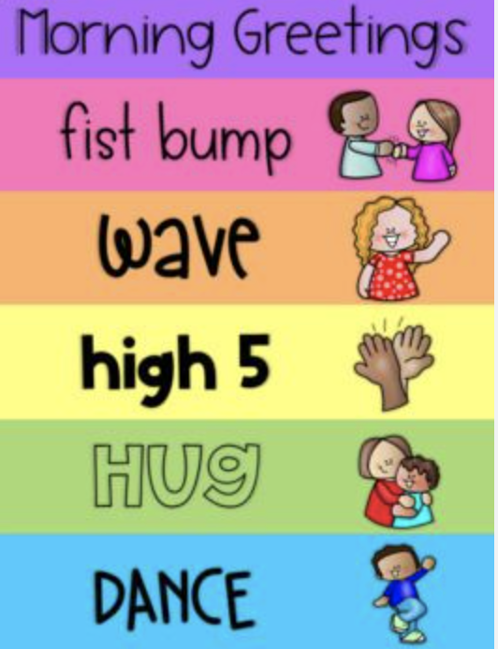
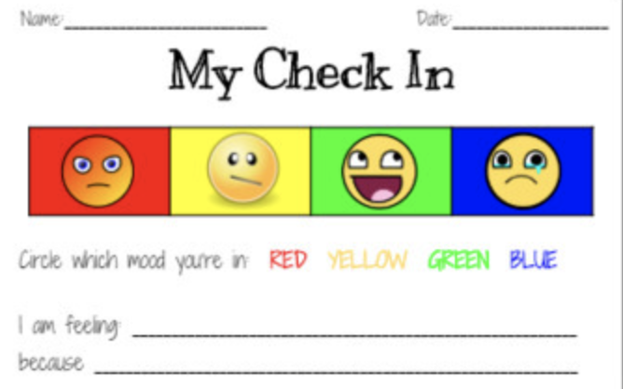
Standard 1
Knowing that students come from all different backgrounds, it is important to implement different tools and strategies for students to express themselves and their feelings. If students are accepted for who they are, it will encourage them to learn and participate in class. One way to do this is by using the 5cs: collaboration, communication, creativity, and critical and computational thinking.
Examples:
Every morning, students will have the autonomy to choose how they would like to be welcomed into the classroom to demonstrate that their voice has power.
Additionally, they will have a daily check-in slip on their desk so they can share their personal goals for the day, as well as express their mood so I can prioritize which students may need additional support throughout the day.

Slide 5
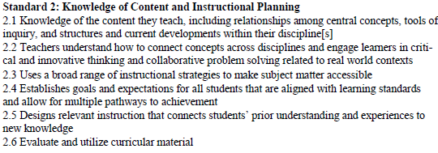
Standard 2: Knowledge of Content & Instructional Planning

Slide 6

Standard 2
Connecting prior knowledge to the new material as it is being introduced is essential, as it is way for students to make stronger and deeper connections across content, disciplines, while retaining and gaining new information.
In this video you will see a student connecting prior knowledge to the book “The Great Turkey Race.”

Slide 7
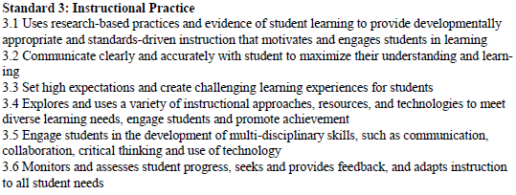
Standard 3: Instructional Practice

Slide 8
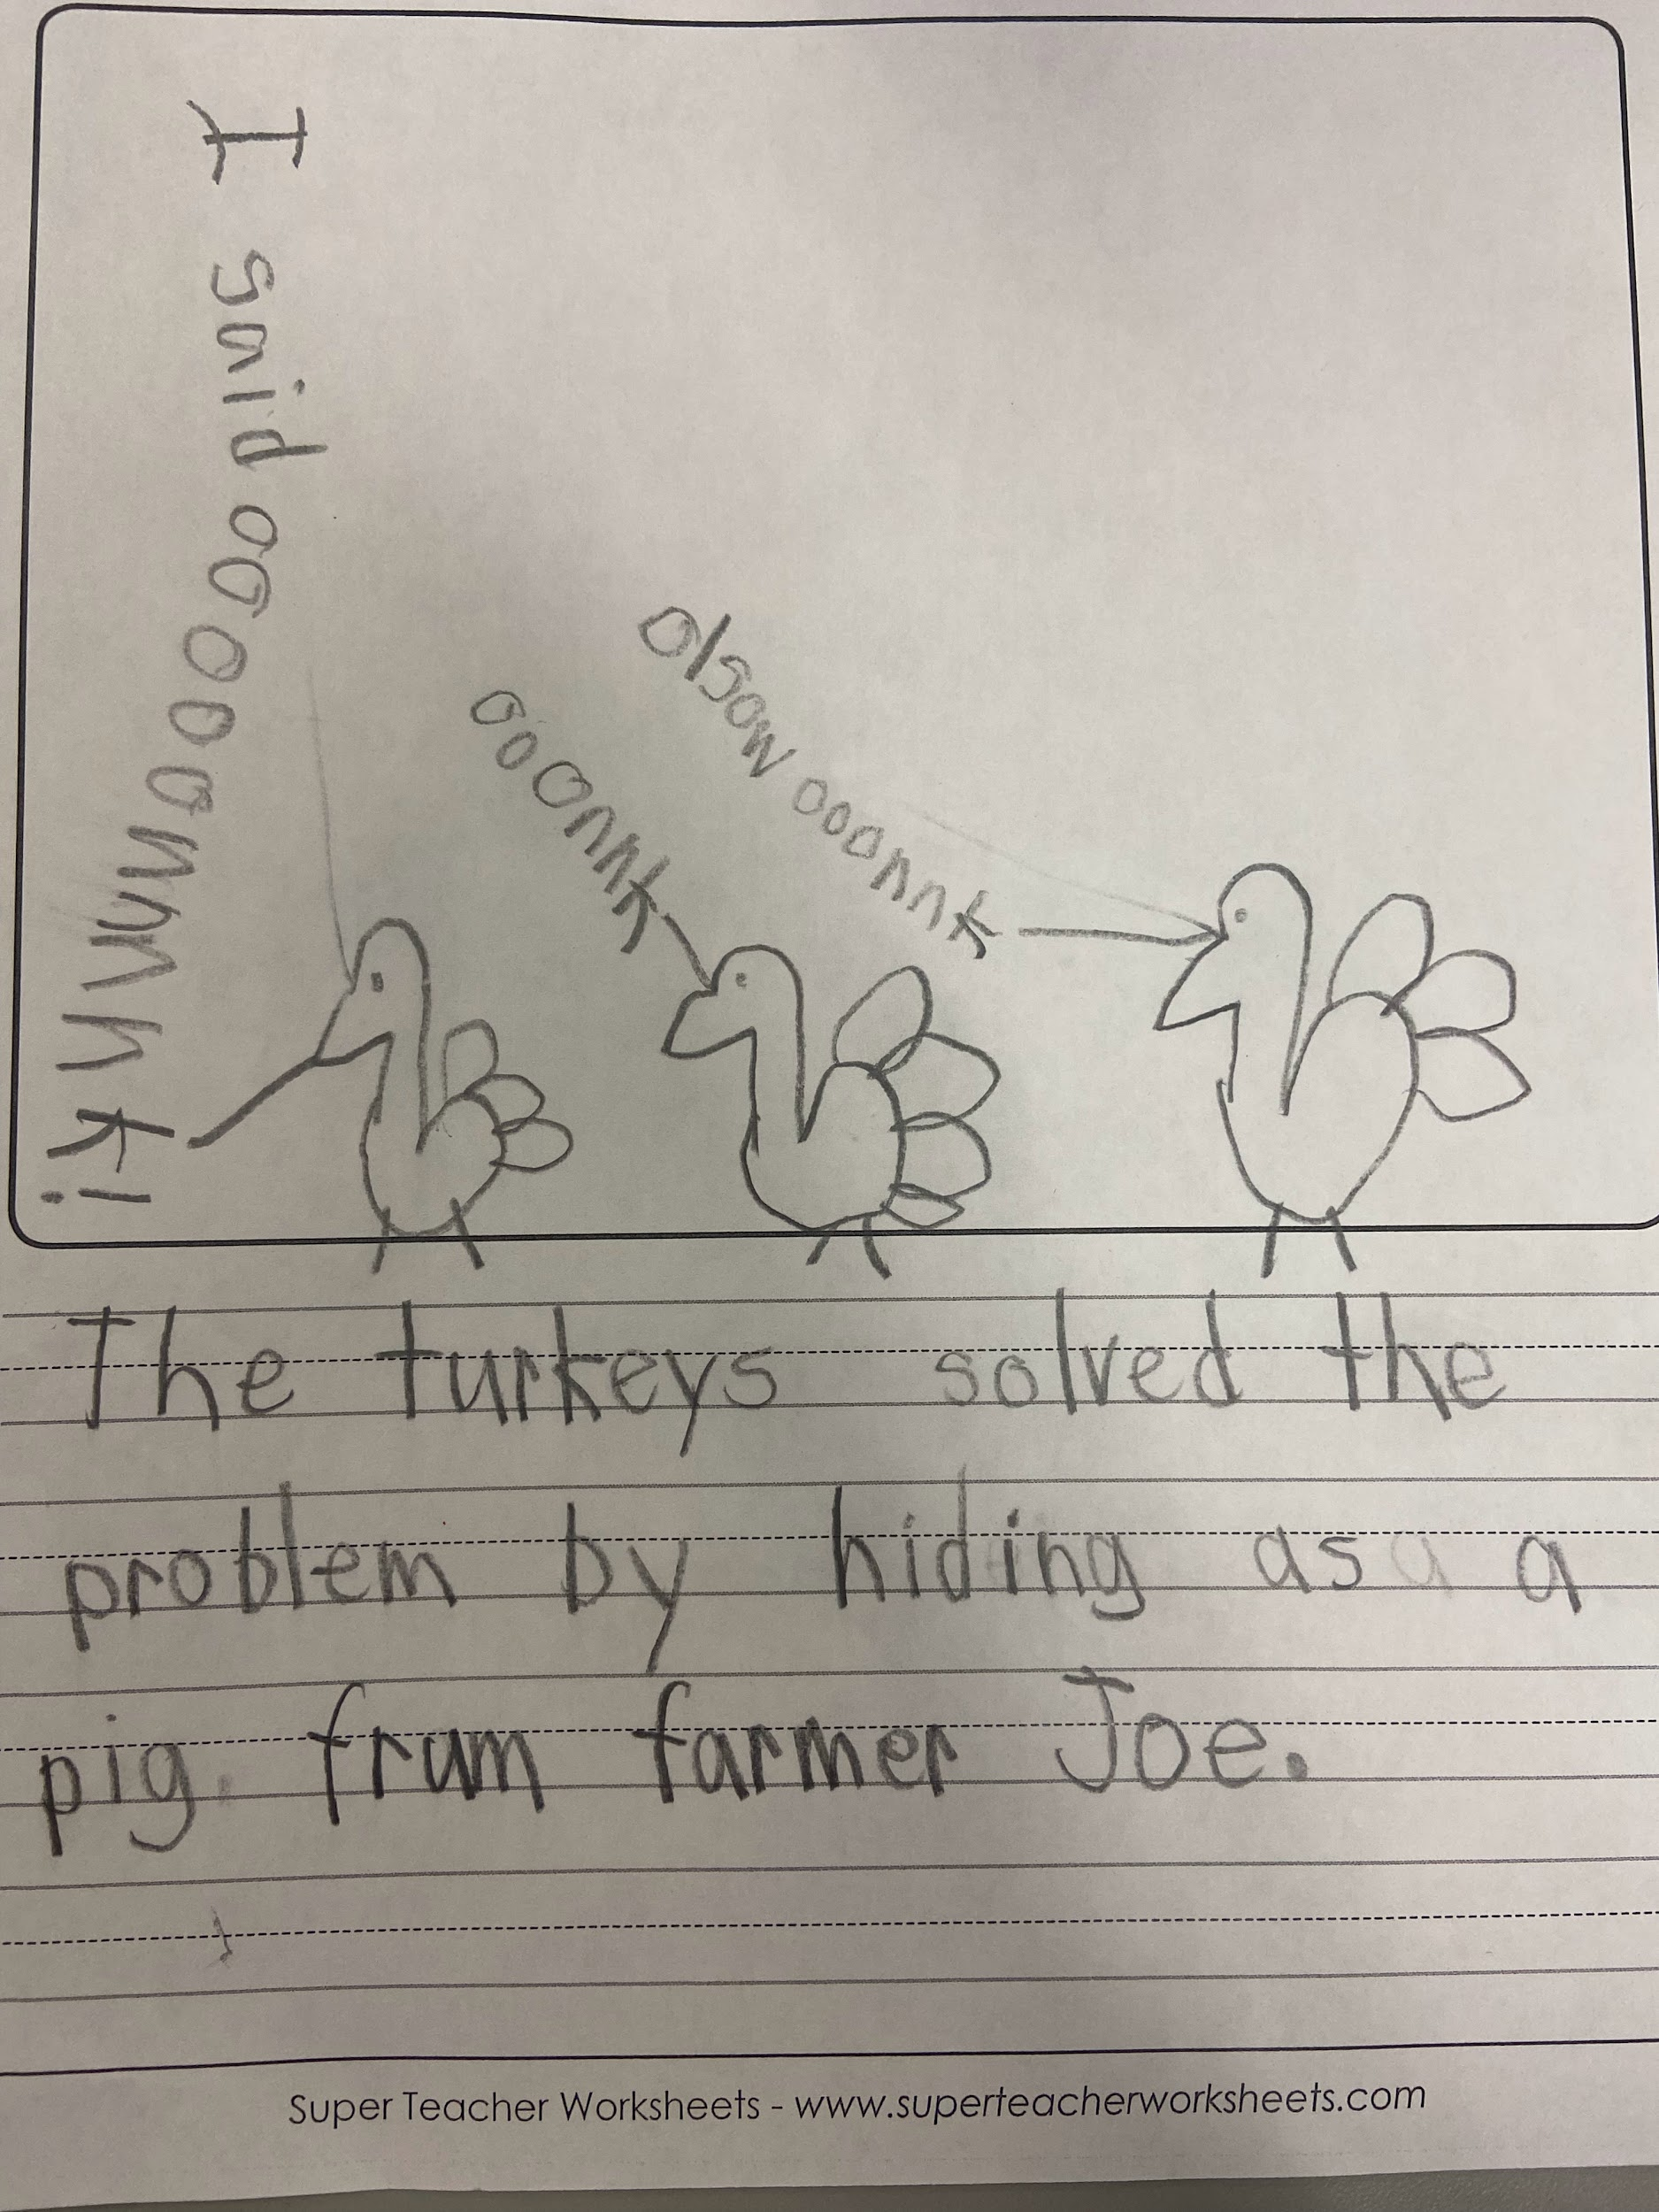
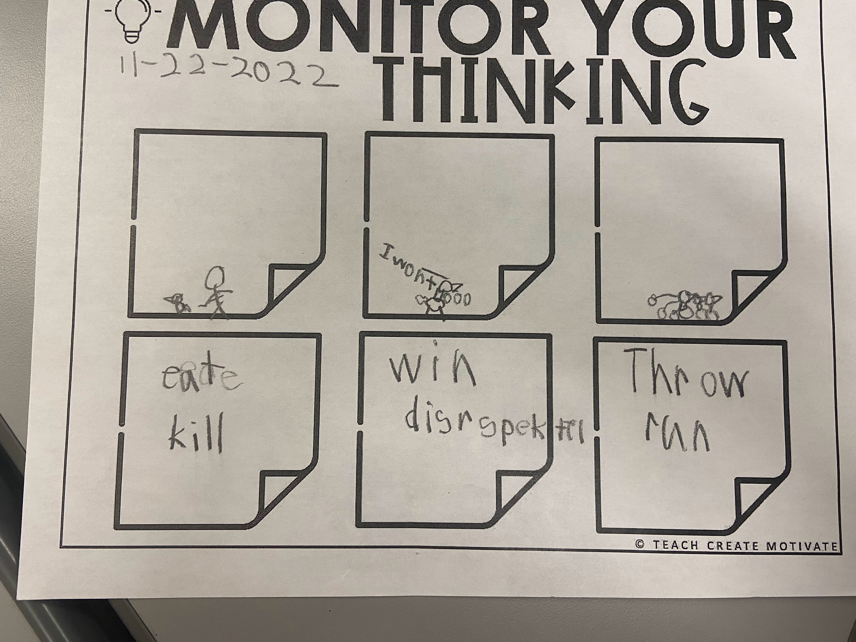
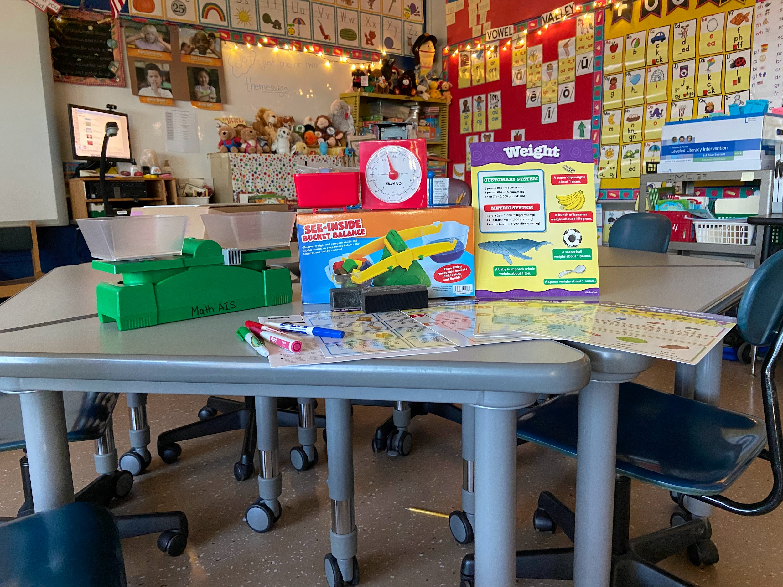
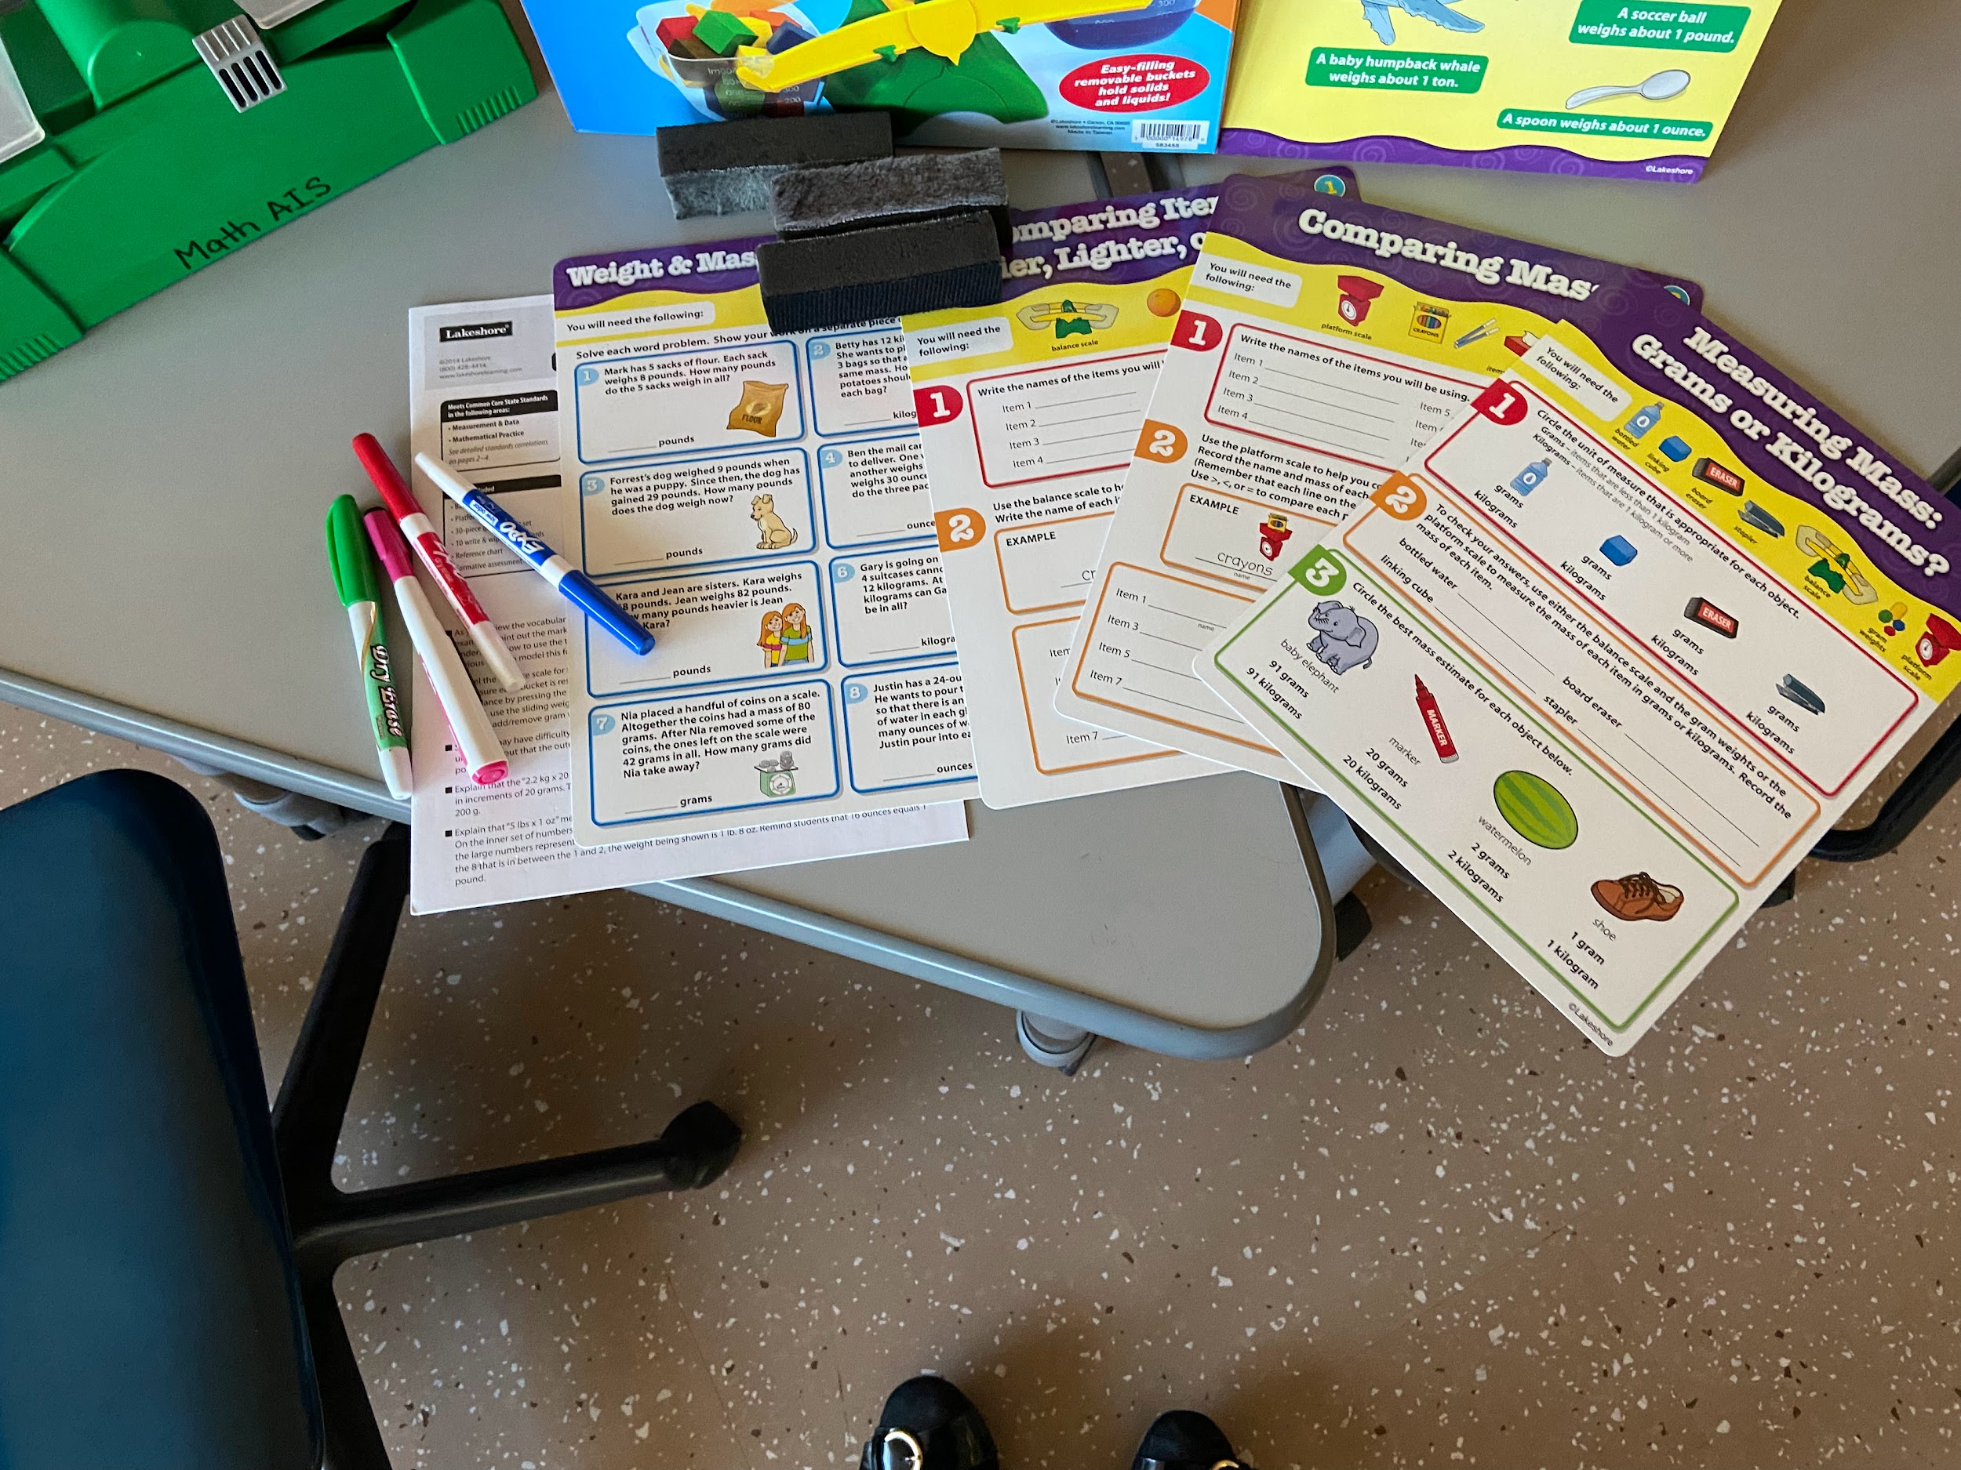
Standard 3
Utilizing different methods to teach students will ensure all learning needs are met. Students learn best when they have multiple ways to understand the same material.
Examples
Different worksheet
Active listening Strategies
Identifying
Expanding on different ideas

Slide 9
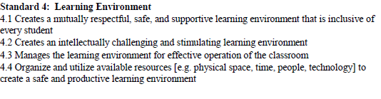
Standard 4: Learning Environment

Slide 10
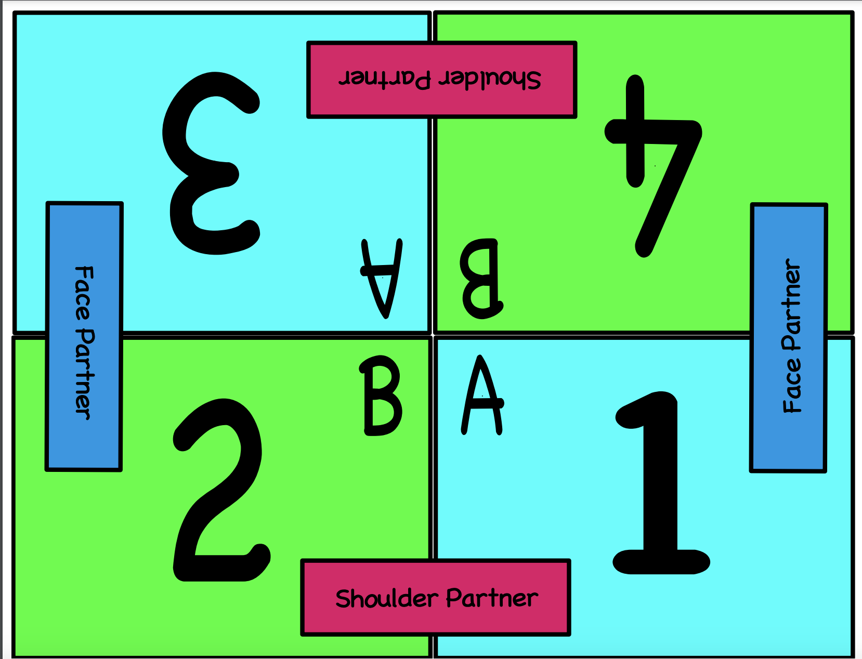
Standard 4
A student’s learning environment is one of the most crucial components to their educational journey, as the students need to feel familiar with their surroundings and the people in it to feel comfortable taking risks. Creating a classroom environment that is accessible for all learners will ensure all students are engaged and feel that their needs are met.
Examples to create a strong learning environment
Having tables with groups of four
Using the Kagan Cooperative learning strategies
Using a quiet signal
Flexible seating for students ex. Wobble stools or standing desks
Center based learning
Organization
Clear rituals and routines
Classroom rules and expectations posted

Slide 11
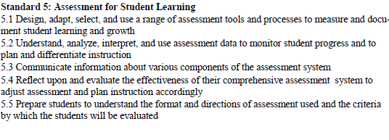
Standard 5:

Slide 12
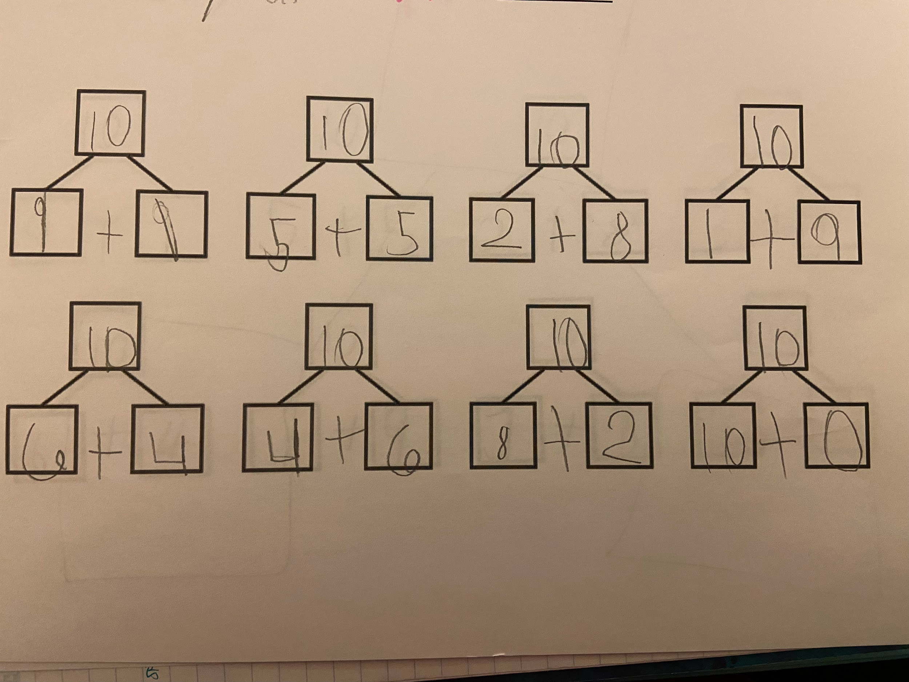
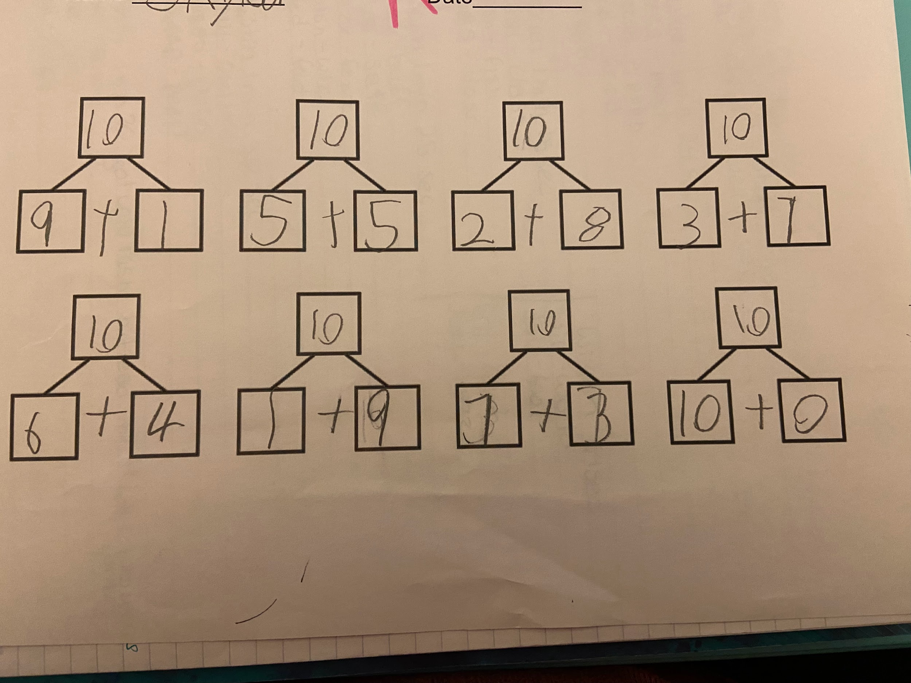
Standard 5
Using different forms of assessment is beneficial when planning lesson and instruction for students. There are many different ways to assess what students know.
Examples:
Kahoot
Jeopardy - Created for 3rd grade students
Response Boards for question and answer
Tests on a unit or chapter
Exit tickets to the right are exit tickets from two different students from a math lesson
Verbal assessment

Slide 13
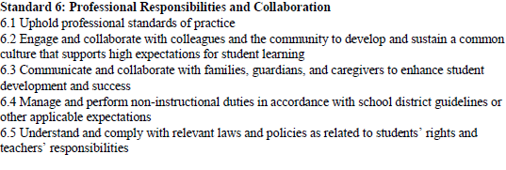
Standard 6: Professional Responsibilities & Collaborations

Slide 14
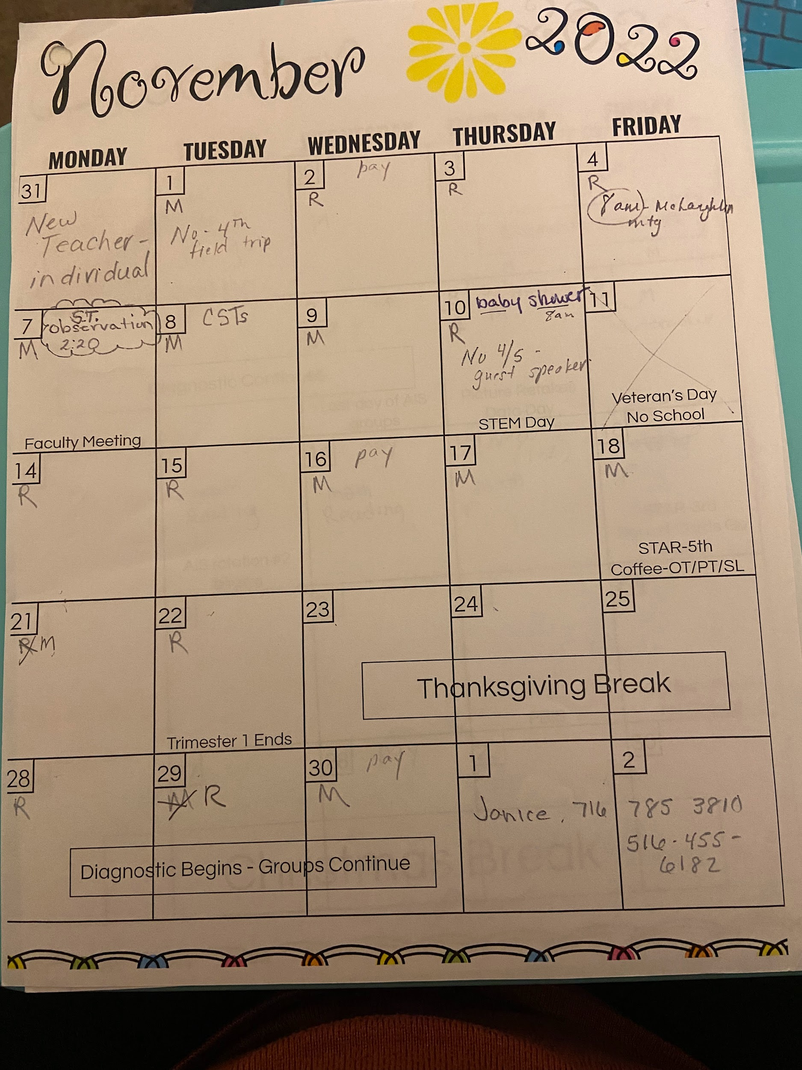
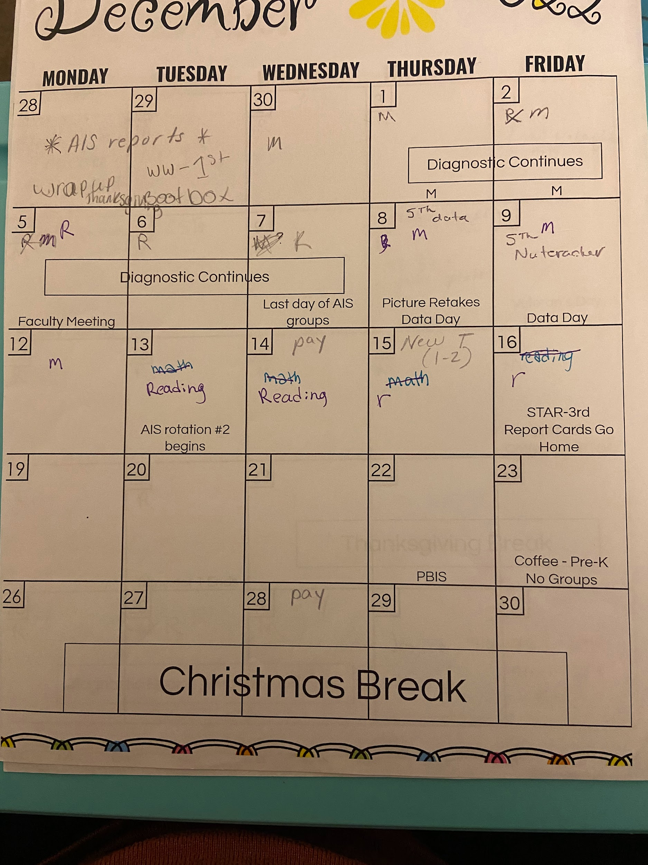
Standard 6
Collaborating with other teachers across disciplines not only strengthens the team but also creates clarity for students. When working as a team with different deadlines and priorities, it is important to have a calendar and schedule so that everyone is on the same page.
Examples
Calendars
Planning days
Monthly meetings
Shared documents
Streamlined communication

Slide 15
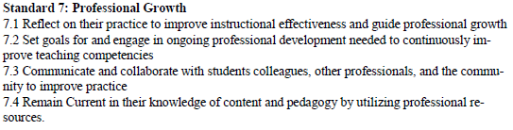
Standard 7:

Slide 16
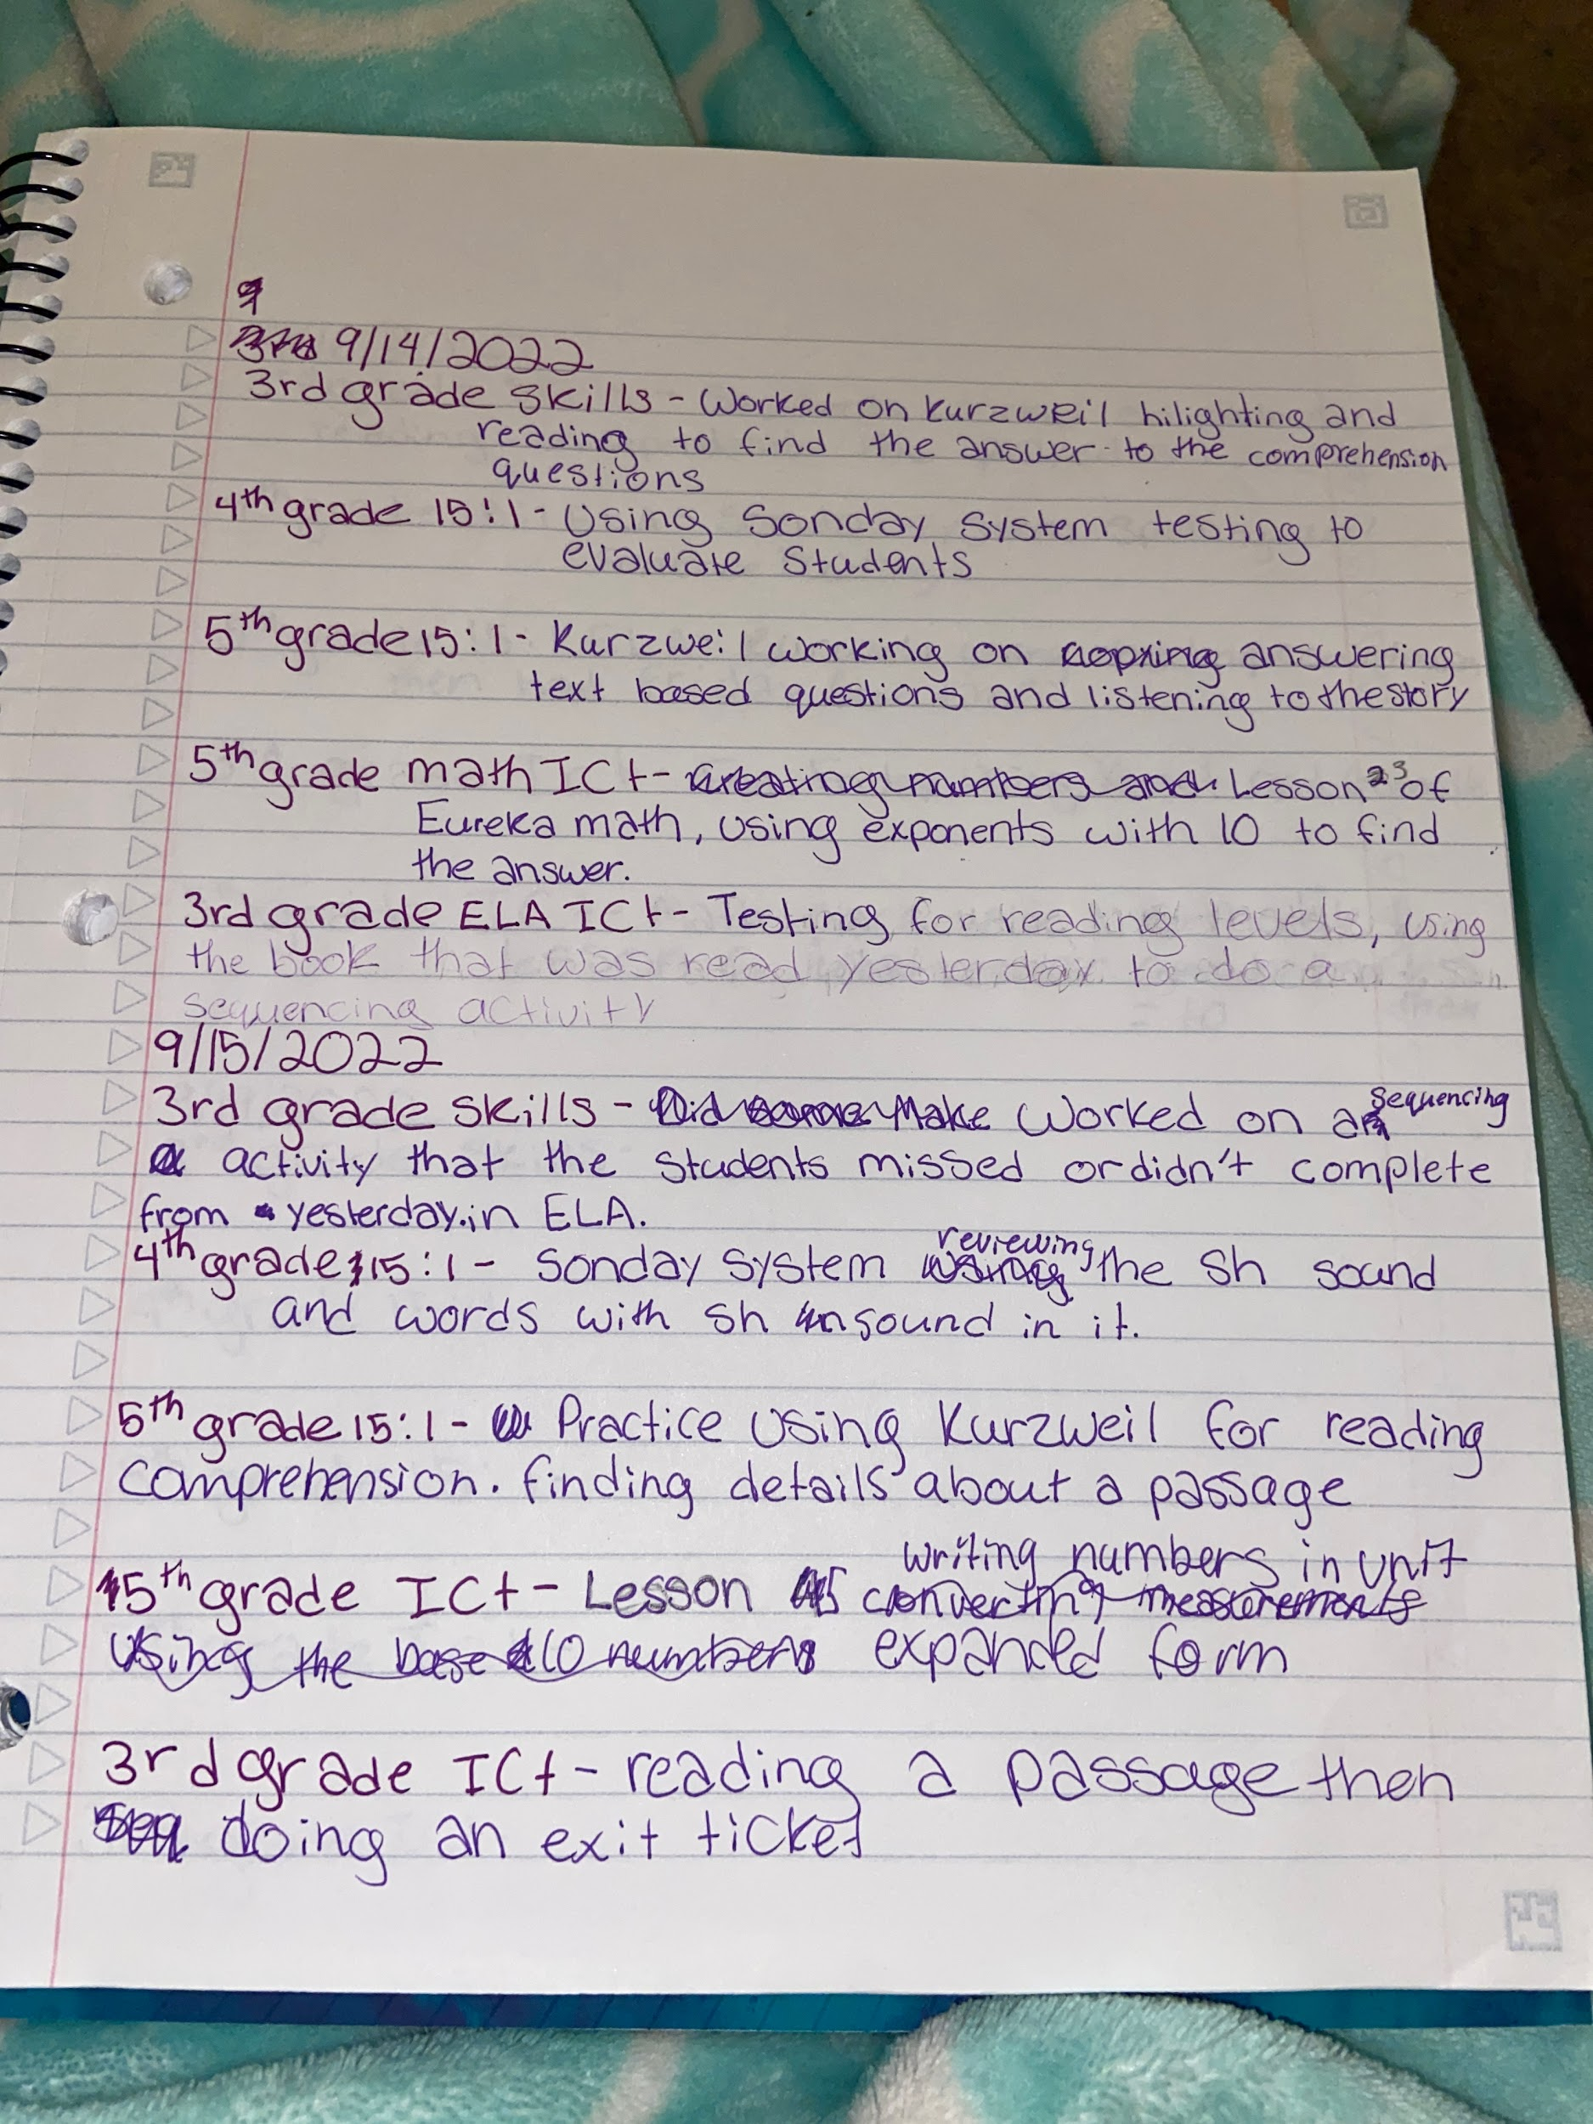
Standard 7
Reflecting on teaching as a whole and daily practice will not only strengthen lesson delivery, but also planning an execution. By taking the time to reflect on what went well and what can be improved, future lessons can be developed in a way that will foster and encourage student and teacher growth alike.
Examples of this
Keeping a journal
Taking notes after every class
Writing reflections

